Slide 1
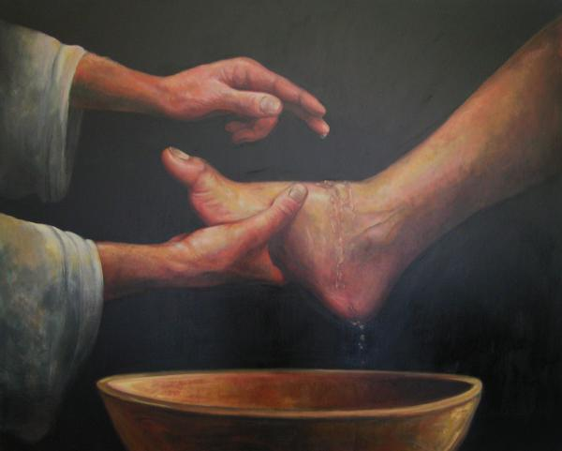
Service Matthew 25:14-30
Sunday October 30th, 2022

Slide 2
“People would rather see a sermon than hear one.”

Slide 3
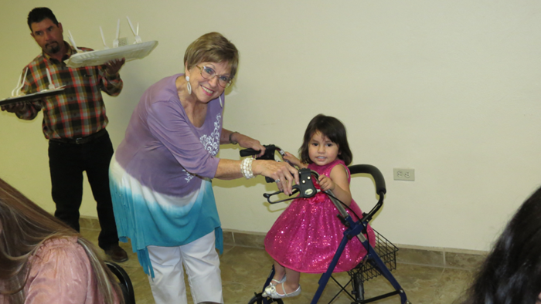

Slide 4
“But those who look into the perfect law, the law of liberty, and persevere,

Slide 5
not being hearers who forget but doers who act—they will be blessed in the doing.”

Slide 6
“They gave themselves first to the Lord, and by the will of God, to us”.

Slide 7
“severe ordeal of affliction… and extreme poverty”.

Slide 8
“abundant joy” and their condition of “extreme poverty…. overflowed in a wealth of generosity”.

Slide 9
“They voluntarily gave according to their means and even beyond their means”.

Slide 10
“the need of the giver to give not the church to receive”.

Slide 11
It blesses others,
blesses God,
blesses the Church
and blesses ourselves.

Slide 12
“Master I knew that you were a harsh man, reaping where you did not sow

Slide 13
and gathering where you did not scatter seed,

Slide 14
so I was afraid and went and hid your talent in the ground”.

Slide 15
“My burden is light and my yoke is easy”

Slide 16
“You’re too hard”.

Slide 17
“I was afraid”.

Slide 18
“Tough times come but they don’t last, but tough people do last”.

Slide 19
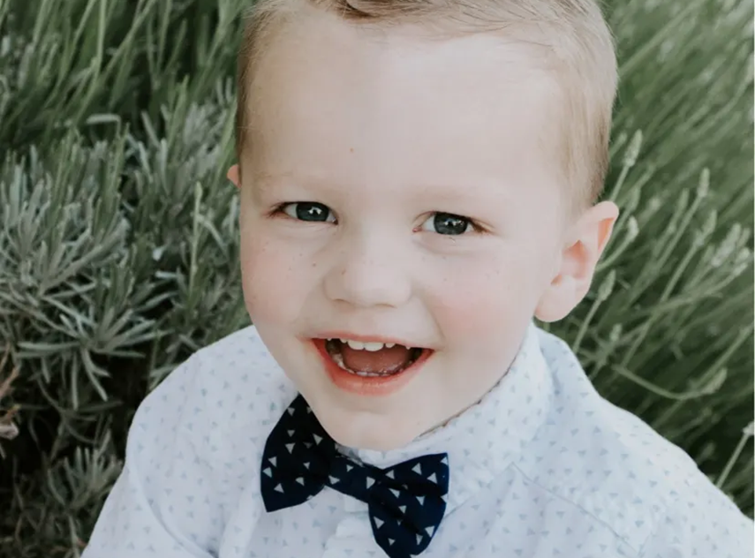

Slide 20
1st, it counters fear with trust in God.

Slide 21
1st, it counters fear with trust in God.
2nd tithing demonstrates that God has first place in your life.

Slide 22
1st, it counters fear with trust in God.
2nd tithing demonstrates that God has first place in your life.
3rd Tithing gives God a chance to prove God exists and wants to bless you.

Slide 23
‘I want you to test me in this… If I will not open for you the windows of heaven and pour out a blessing…’

Slide 24
1st, Tithing counters fear with trust in God.
2nd, Tithing demonstrates that God has first place in your life.
3rd, Tithing gives God a chance to prove God exists and wants to bless you.
4th, Tithing reminds us everything is given to us by God.

Slide 25
“For if the eagerness is there, the gift is acceptable according to what one has – not to what one does not have”.

Slide 26
“Through Jesus, therefore, let us continually offer to God

Slide 27
a sacrifice of praise—the fruit of lips that openly profess his name.

Slide 28
And do not forget to do good and to share with others,

Slide 29
for with such sacrifices God is pleased.”

