Slide 1
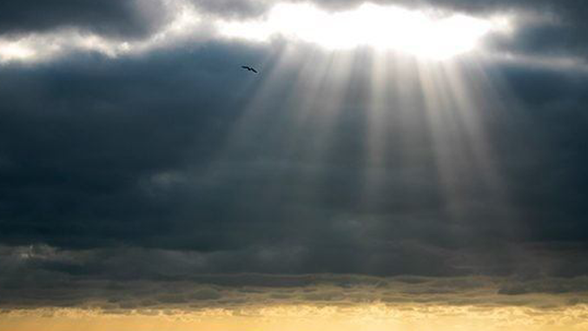
Presence
Matt. 11:28-30, Heb. 10:23-25
Sunday October 23rd, 2022

Slide 2
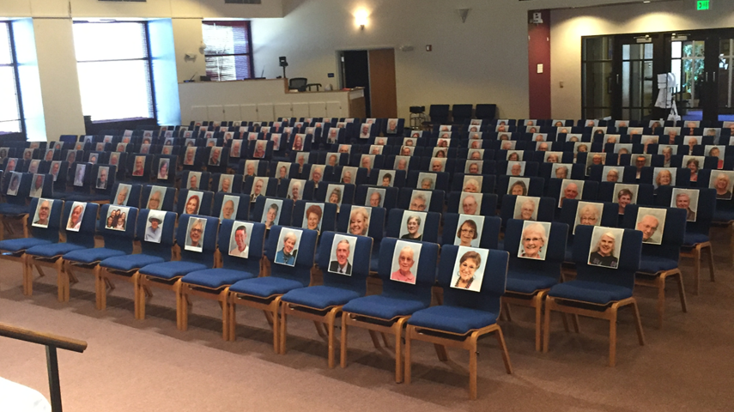

Slide 3
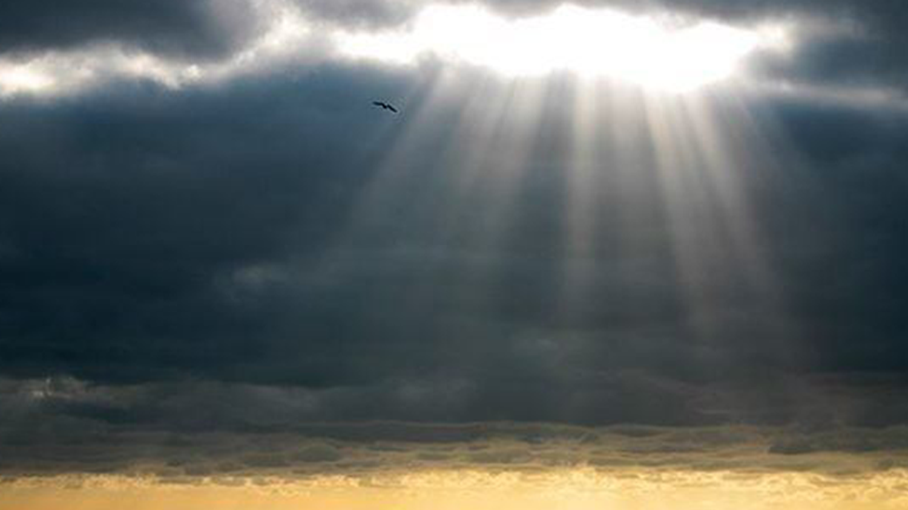
“prayers, presence, gifts, service and witnessing.”

Slide 4
“And let us consider how we may spur one another on toward love and good deeds,

Slide 5
not giving up meeting together, as some are in the habit of doing, but encouraging one another—

Slide 6
—and all the more as you see the Day approaching.”

Slide 7
Being present blesses
Self,
God,
Others,
and the Church.

Slide 8
To begin with Jesus invites us into HIS presence!

Slide 9
“COME to Me, all you who are weary and burdened, and I will give you rest.”

Slide 10
“He gives his beloved rest.”

Slide 11
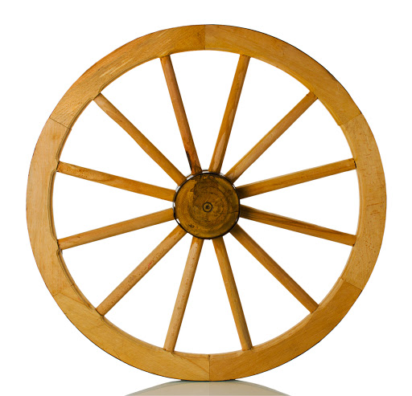

Slide 12
First, your presence blesses others!

Slide 13
Second, our Presence blesses God!

Slide 14
“Praise God in his holy house of worship. Let every living, breathing creature praise God”!

Slide 15
“Observe the Sabbath day to keep it holy”.

Slide 16
Third, our presence blesses the institution of the Church.

Slide 17
Fourth, our Presence blesses us!

Slide 18
“You yourselves are our letter, written on our hearts, to be known and read by all; and you show that you are a letter of Christ, prepared by us,

Slide 19
written not with ink but with the Spirit of the living God, not on tablets of stone but on tablets of human hearts.”

Slide 20
“I Saw Jesus in Your Eyes”.

Slide 21
I’ve seen Jesus in our midst, and I’ve seen Jesus in your eyes.”

Slide 22
“Come to me, all you who are weary and burdened, and I will give you rest.

Slide 23
Take my yoke upon you and learn from me, for I am gentle and humble in heart, and you will find rest for your souls.

Slide 24
For my yoke is easy and my burden is light.”

