Slide 1
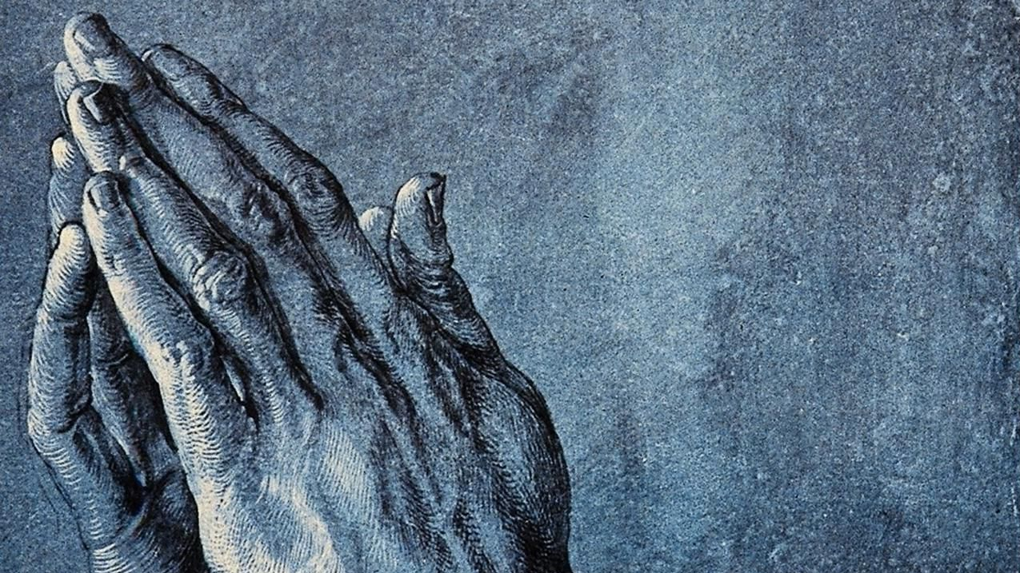
“The Vows-Prayer”
Esther 4:4-17, 1 Thessalonians 3:9-13
Sunday October 16th, 2022

Slide 2
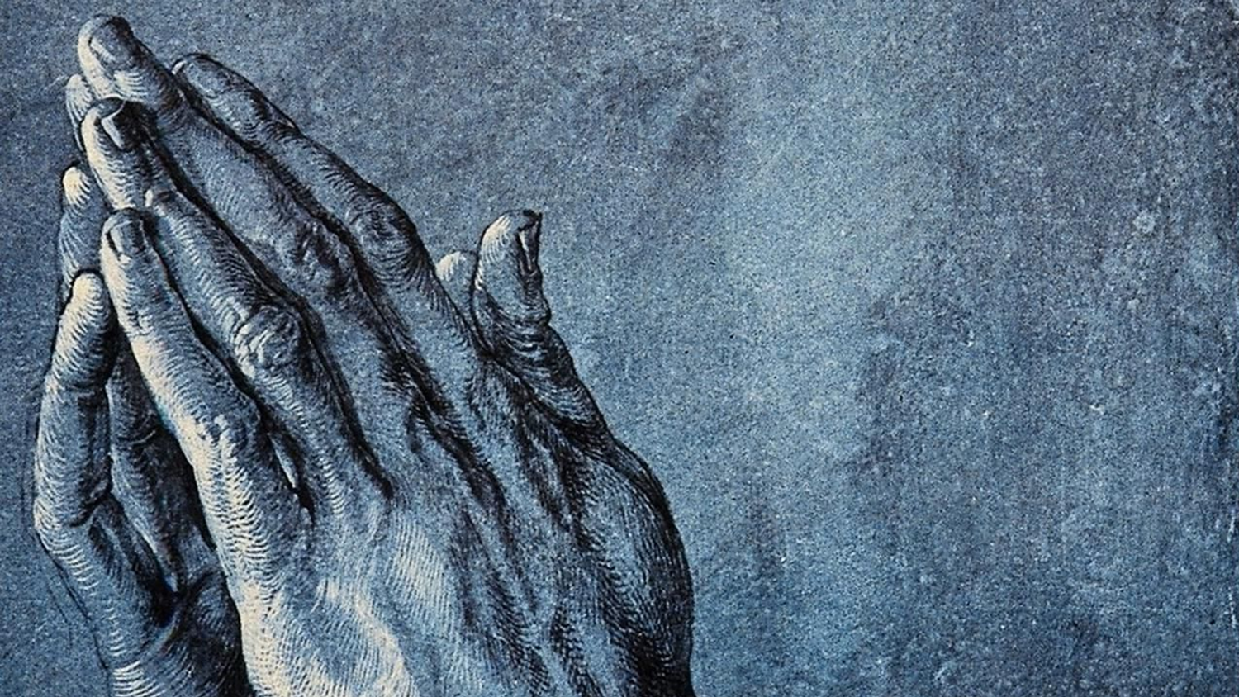
“You were created for such a time as this.”

Slide 3
“I woke up this morning
Saw a world full of trouble now
I thought, "How'd we ever get so far down?"

Slide 4
And "How's it ever gonna turn around?"
So, I turned my eyes to Heaven,
I thought, "God, why don't You do something?"

Slide 5
He said, "I did. I created you."

Slide 6
Prayer,
Presence,
Gifts, Service,
and Witnessing

Slide 7
“The Vows.”

Slide 8
We are made in the image of a giving God, so to be who we were created to be, we need to give.

Slide 9
Mordecai

Slide 10
“Perhaps, who knows…”

Slide 11
“If I perish, I perish.”

Slide 12
“How can we thank God enough for you.”

Slide 13
“You became imitators of us and of the Lord; in spite of severe suffering,

Slide 14
you welcomed the message with the joy given by the Holy Spirit”.

Slide 15
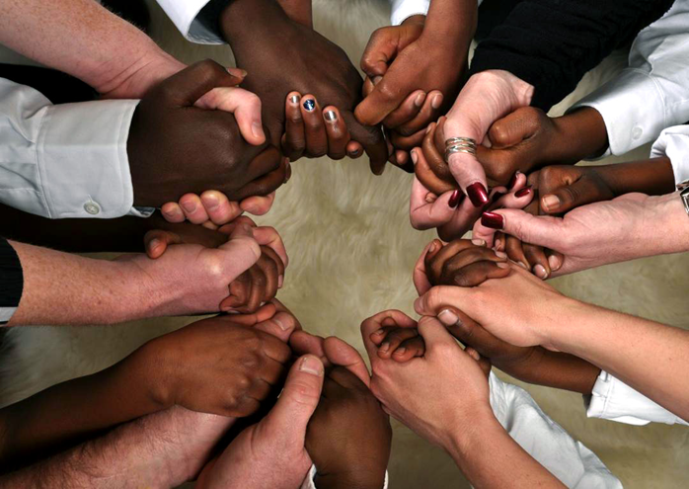

Slide 16
Prayer links us together in love.

Slide 17
“How can we thank God enough for you in return for all the joy that we feel before our God because of you?

Slide 18
Night and day, we pray most earnestly that we may see you face to face and restore whatever is lacking in your faith.”

Slide 19
“God is love.”

Slide 20
“that we may see you face to face and restore whatever is lacking in your faith”.

Slide 21
“Behind all words, all thoughts and feelings, there is an inner core of prayer where our hearts are united in the presence of God”.

Slide 22
“And may the Lord make you increase and abound in love for one another and for all, just as we abound in love for you”.

Slide 23
Prayers, presence, gifts, service and witness are all linked together and link us together in love.

Slide 24
“God Bless You”

Slide 25
